Slide 1
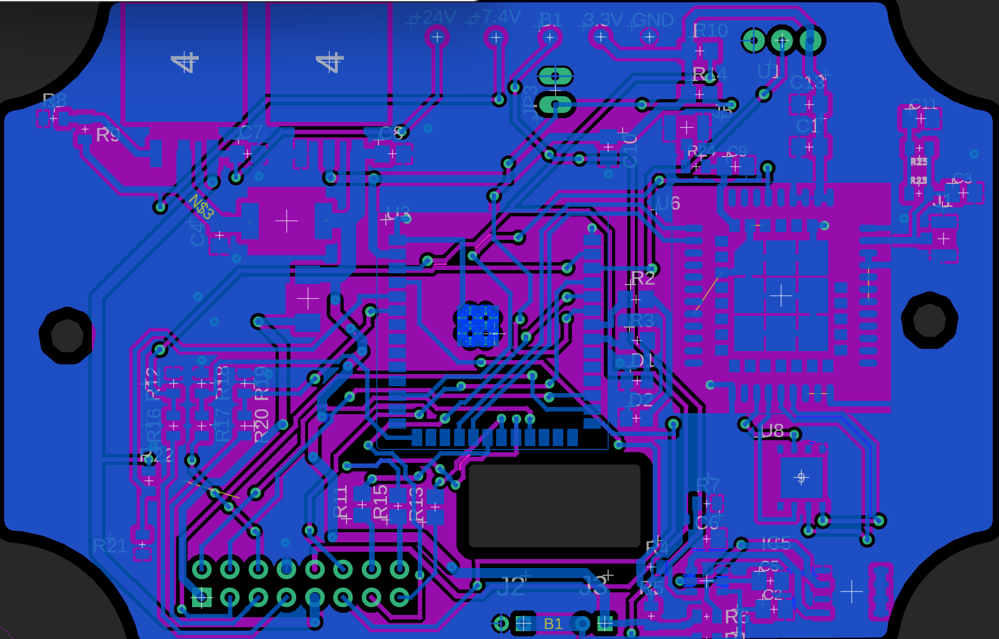
Harsh Environment Sensor Board V2
Joseph Portera
Jordan Anger
Jasper Everitt
Anthony Sedore

Slide 2
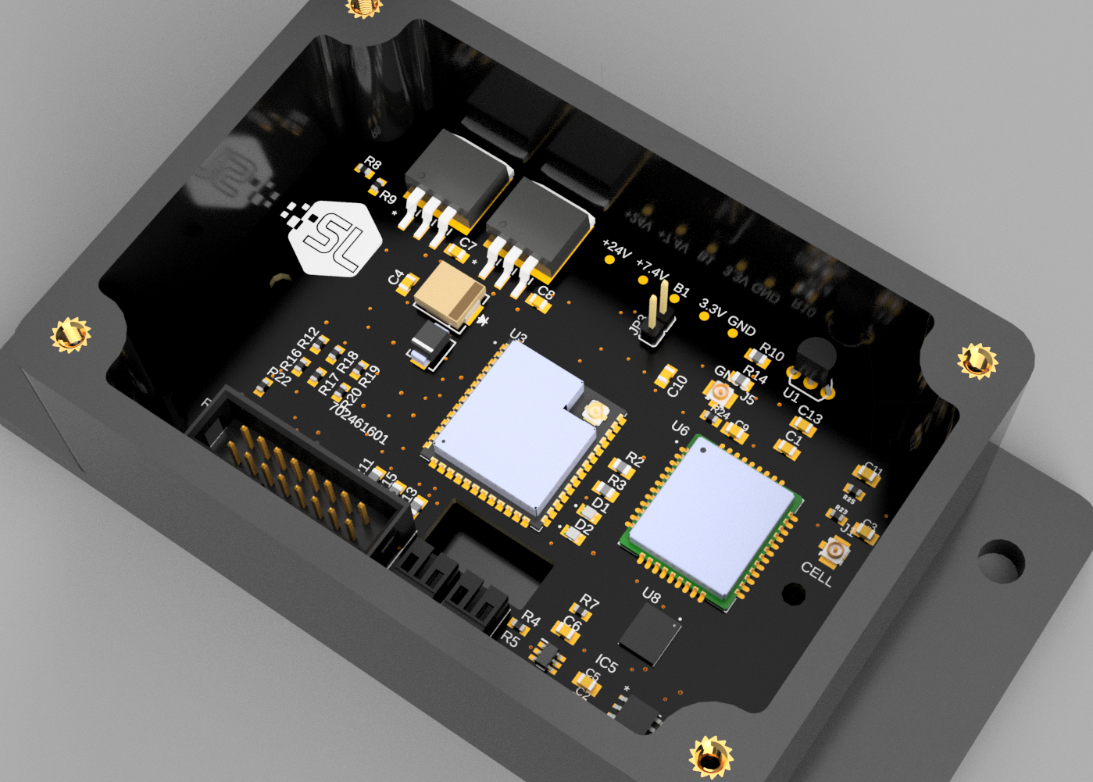
HArsh Environment Sensor Version 2
•The project involves developing a sensor system for harsh environments, including power regulation, communication interfaces, logic control, and battery management.
•The purpose of the PCB is to collect data and forward it through wireless channels to Software Logistics' web platform NuvIoT for remote monitoring and data analysis

Slide 3
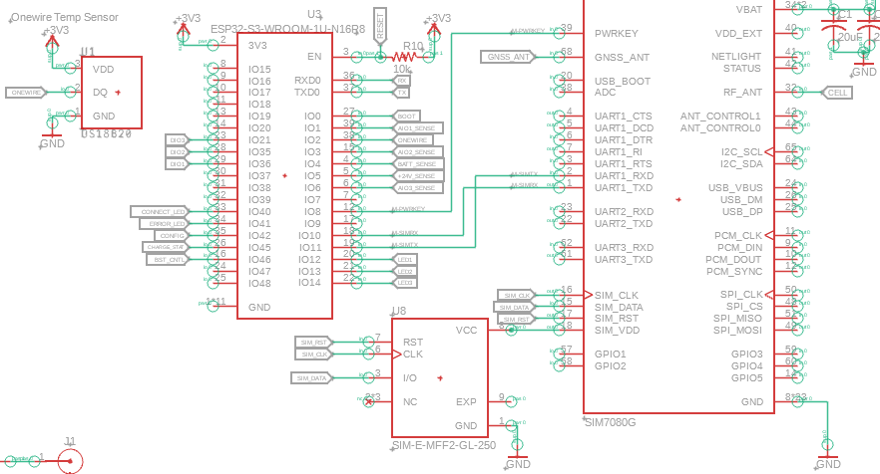
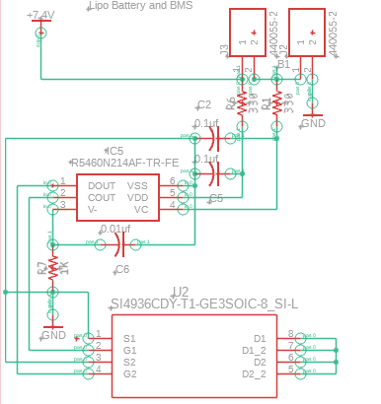
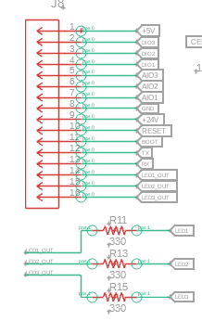
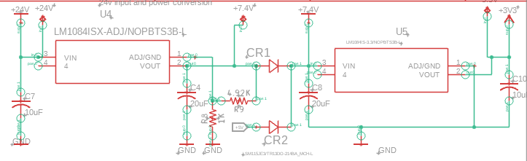
Technical Design

Slide 4
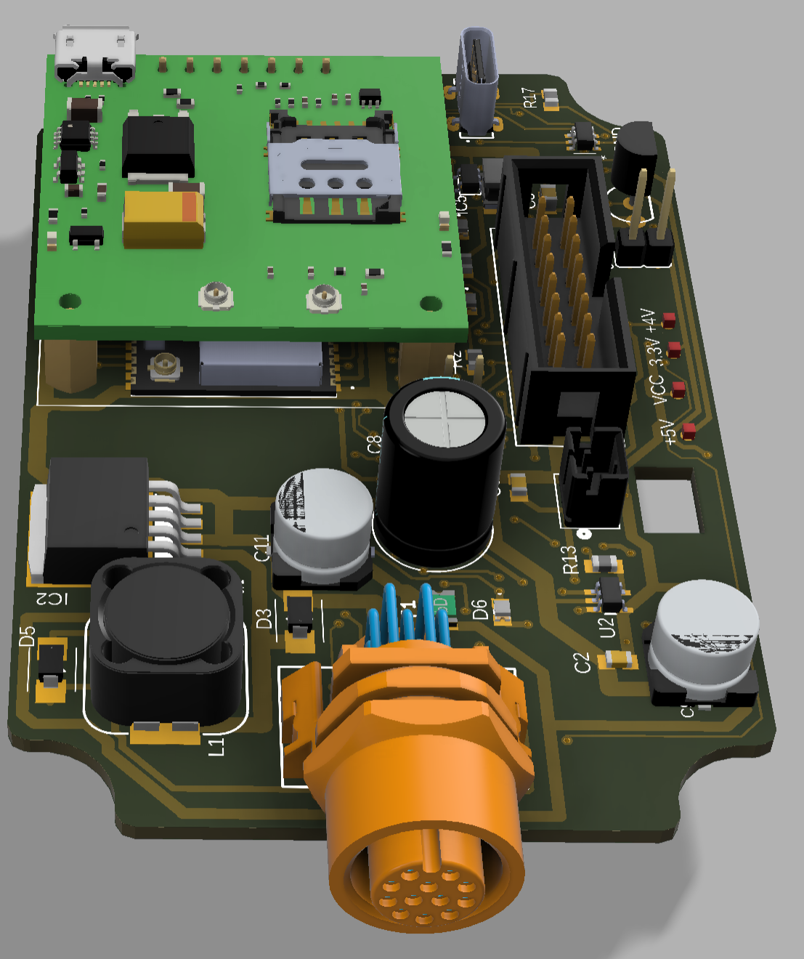
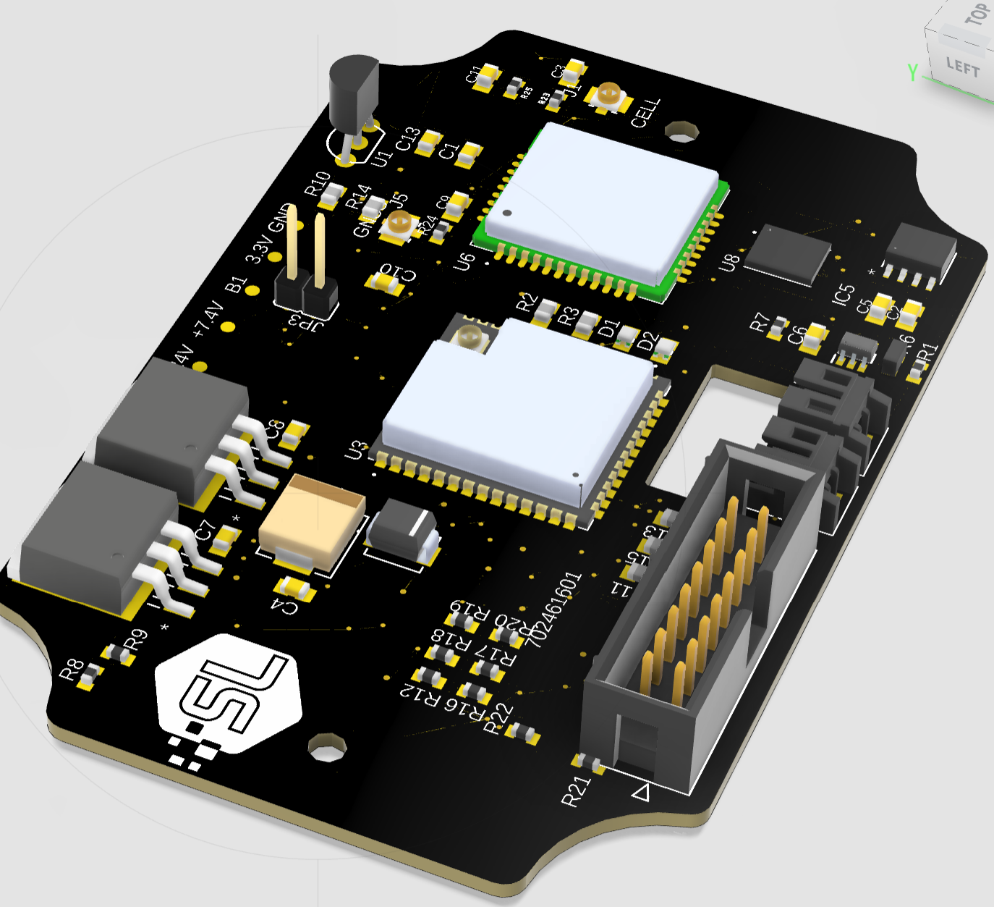
V1
V2

Slide 5
System Diagram
7.4v
Chrg/DsChrg
24V
7.4V Regulator
7.4V BUS
Lithium Battery Monitoring
LIpo Cell
24VDC IN
4.2v Balancing
LIpo Cell
3.3V Regulator
5VDC IN
Diode
Status
LED
3X Analog Signal Input
3X Digital Signal Input
ESP-32
3.3V BUS
Status
LED
Ser Data
Status
LED
High/Low
BOOT_CMD
Analog Volts
Voltage Divider
High/Low
SLP_CMD
High/Low
CFG_CMD
Temp Sensor
3.3v
High/Low
Ser Data
RST_CMD
Ser Data
SIMCOM Networking (4G LTE)
TX/RX
Compressed Data

Slide 6
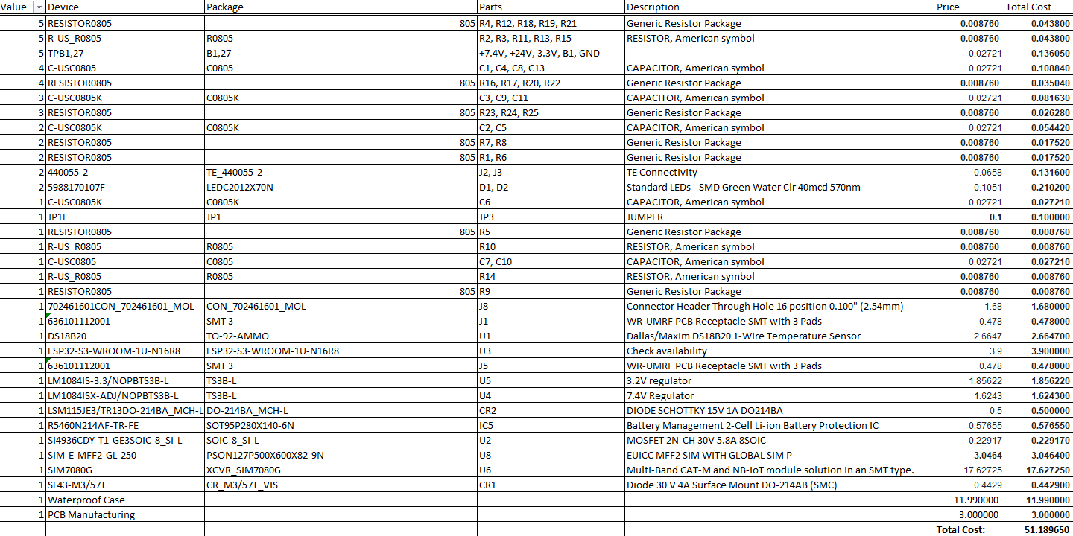
Bill Of Materials
Total Cost per Unit: $51.19

Slide 7
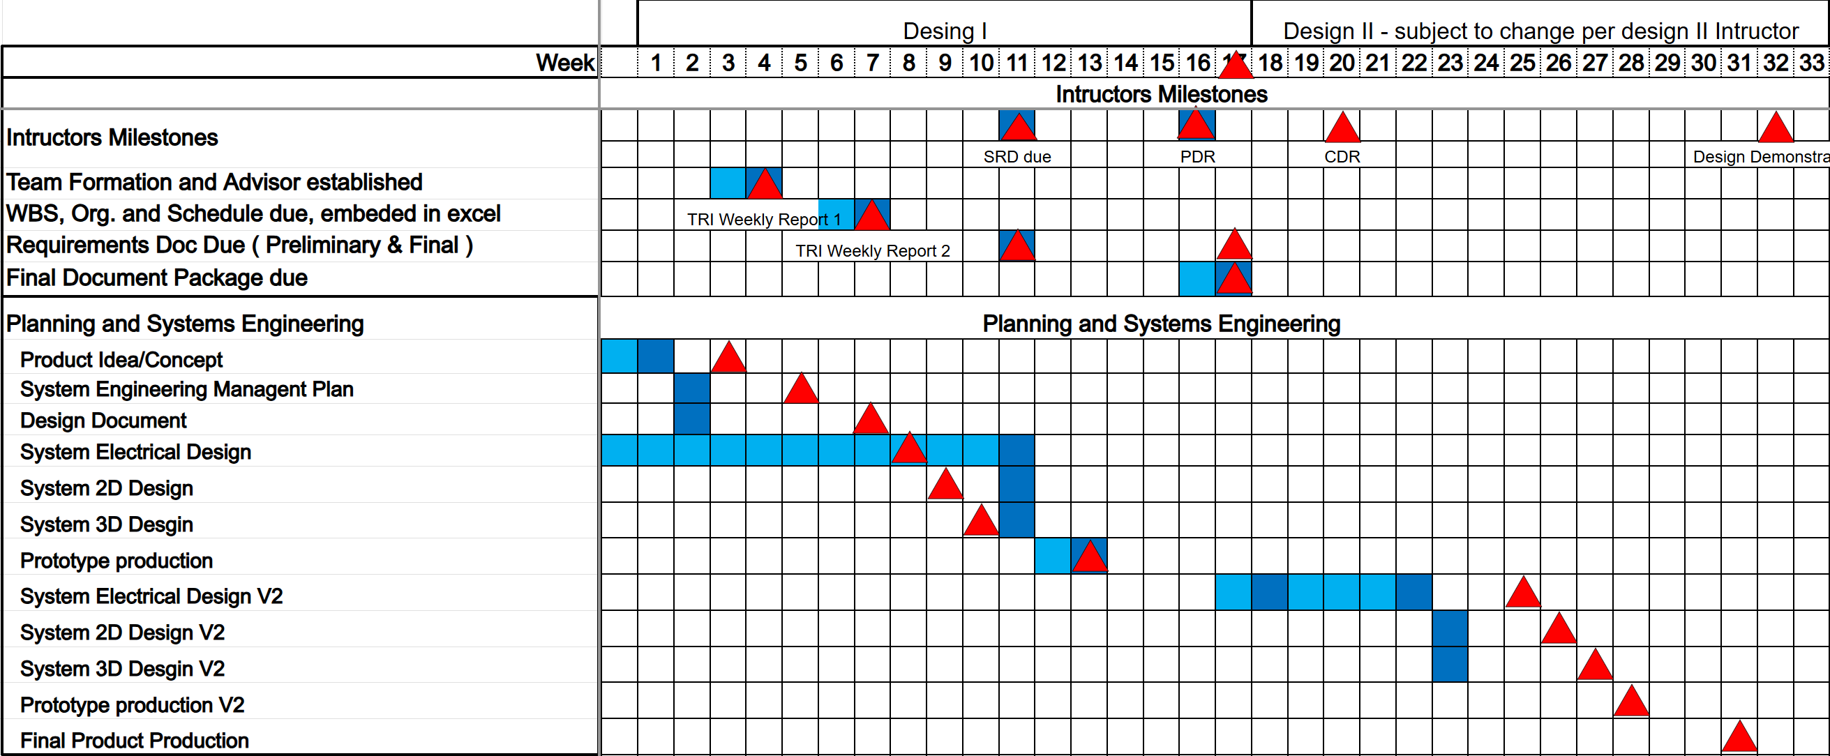

Schedule and Plan

Slide 8
Testing Plan
For our Testing plan, we pinpointed 5 key components of our PCB to ensure that our design worked efficiently for its use cases. We decided to test:
Power Distribution
UART Communication
GPIO Control
Battery Management System operation
Sensor Functionality
By testing these 5 components, we verified that our PCB worked in multiple different areas of the design and could operate in the different harsh conditions, having access to battery power and sensing capabilities along with being able to communicate with operators.

Slide 9
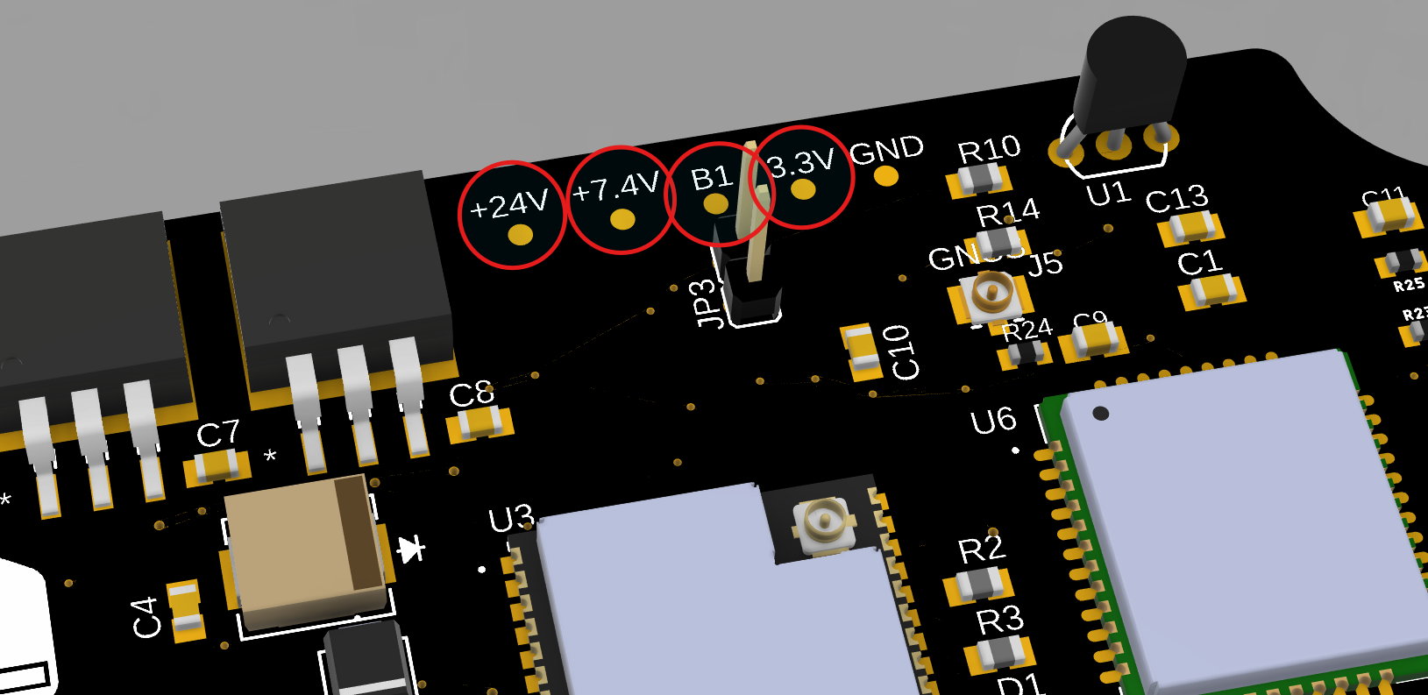
Voltage Test Points

Slide 10
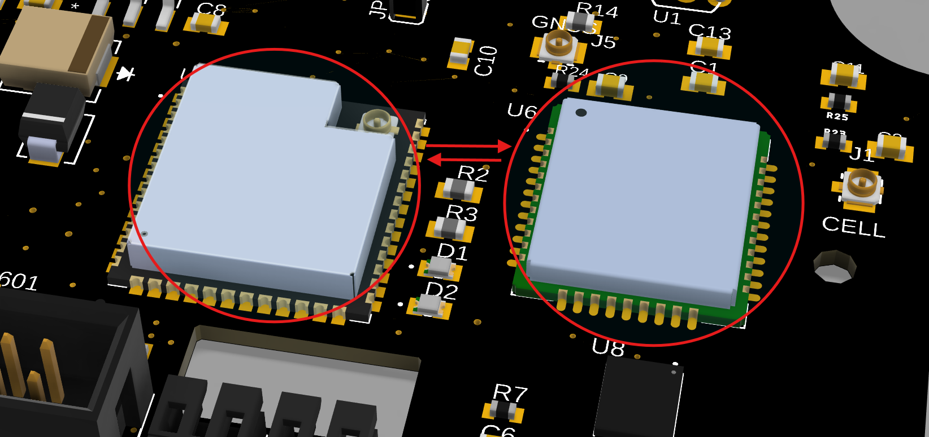
ESP+SIMCOM UART

Slide 11
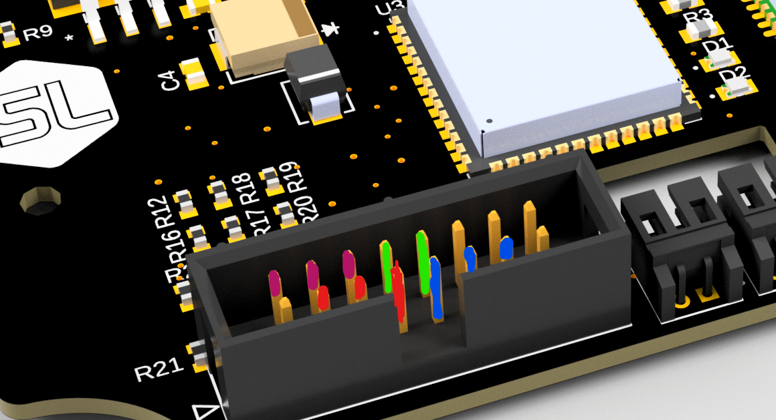
EXT IO Test
DIG IO
ANLG IO
TX/RX
LED

Slide 12
Risk Assessment
Some of the risks with our project include:
Communications system not working
Battery malfunctions
Supplies for building PCBs not arriving
Failure of system controllers
Reworking the PCB design
To mitigate these risks and work around them to complete project deadlines, we took steps to rigorously test each of the PCB system’s components. We made sure to complete these tests early into the design to not be hindered by obtaining new parts or PCB boards for the product.
As we iterated on the design during our design process, we created working prototypes at different stages of the PCB before adding new components to make sure that our systems worked properly. By mitigating this risk during our design process instead of afterwords, we were able to rework and add new features to our project.

Slide 13
Conclusion
In conclusion, we have built a working PCB that is capable of sensing different environmental factors and communicating data to operators of the PCB. It is capable of powering each of its components off battery power to allow it to function in harsh environments without a constant power source.
As we proceed on this project into the future, we are creating different design iterations to fit the more specific needs of our sponsor such as using multiple ground planes and introducing an antenna into the design.

